Slide 1

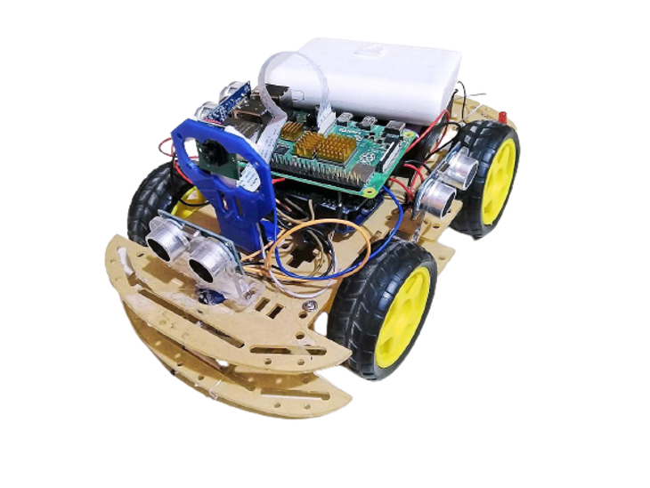
Rover ALTAIF
Supervised by:
Dr. Mahmoud Abd ElAaL
1

Slide 2
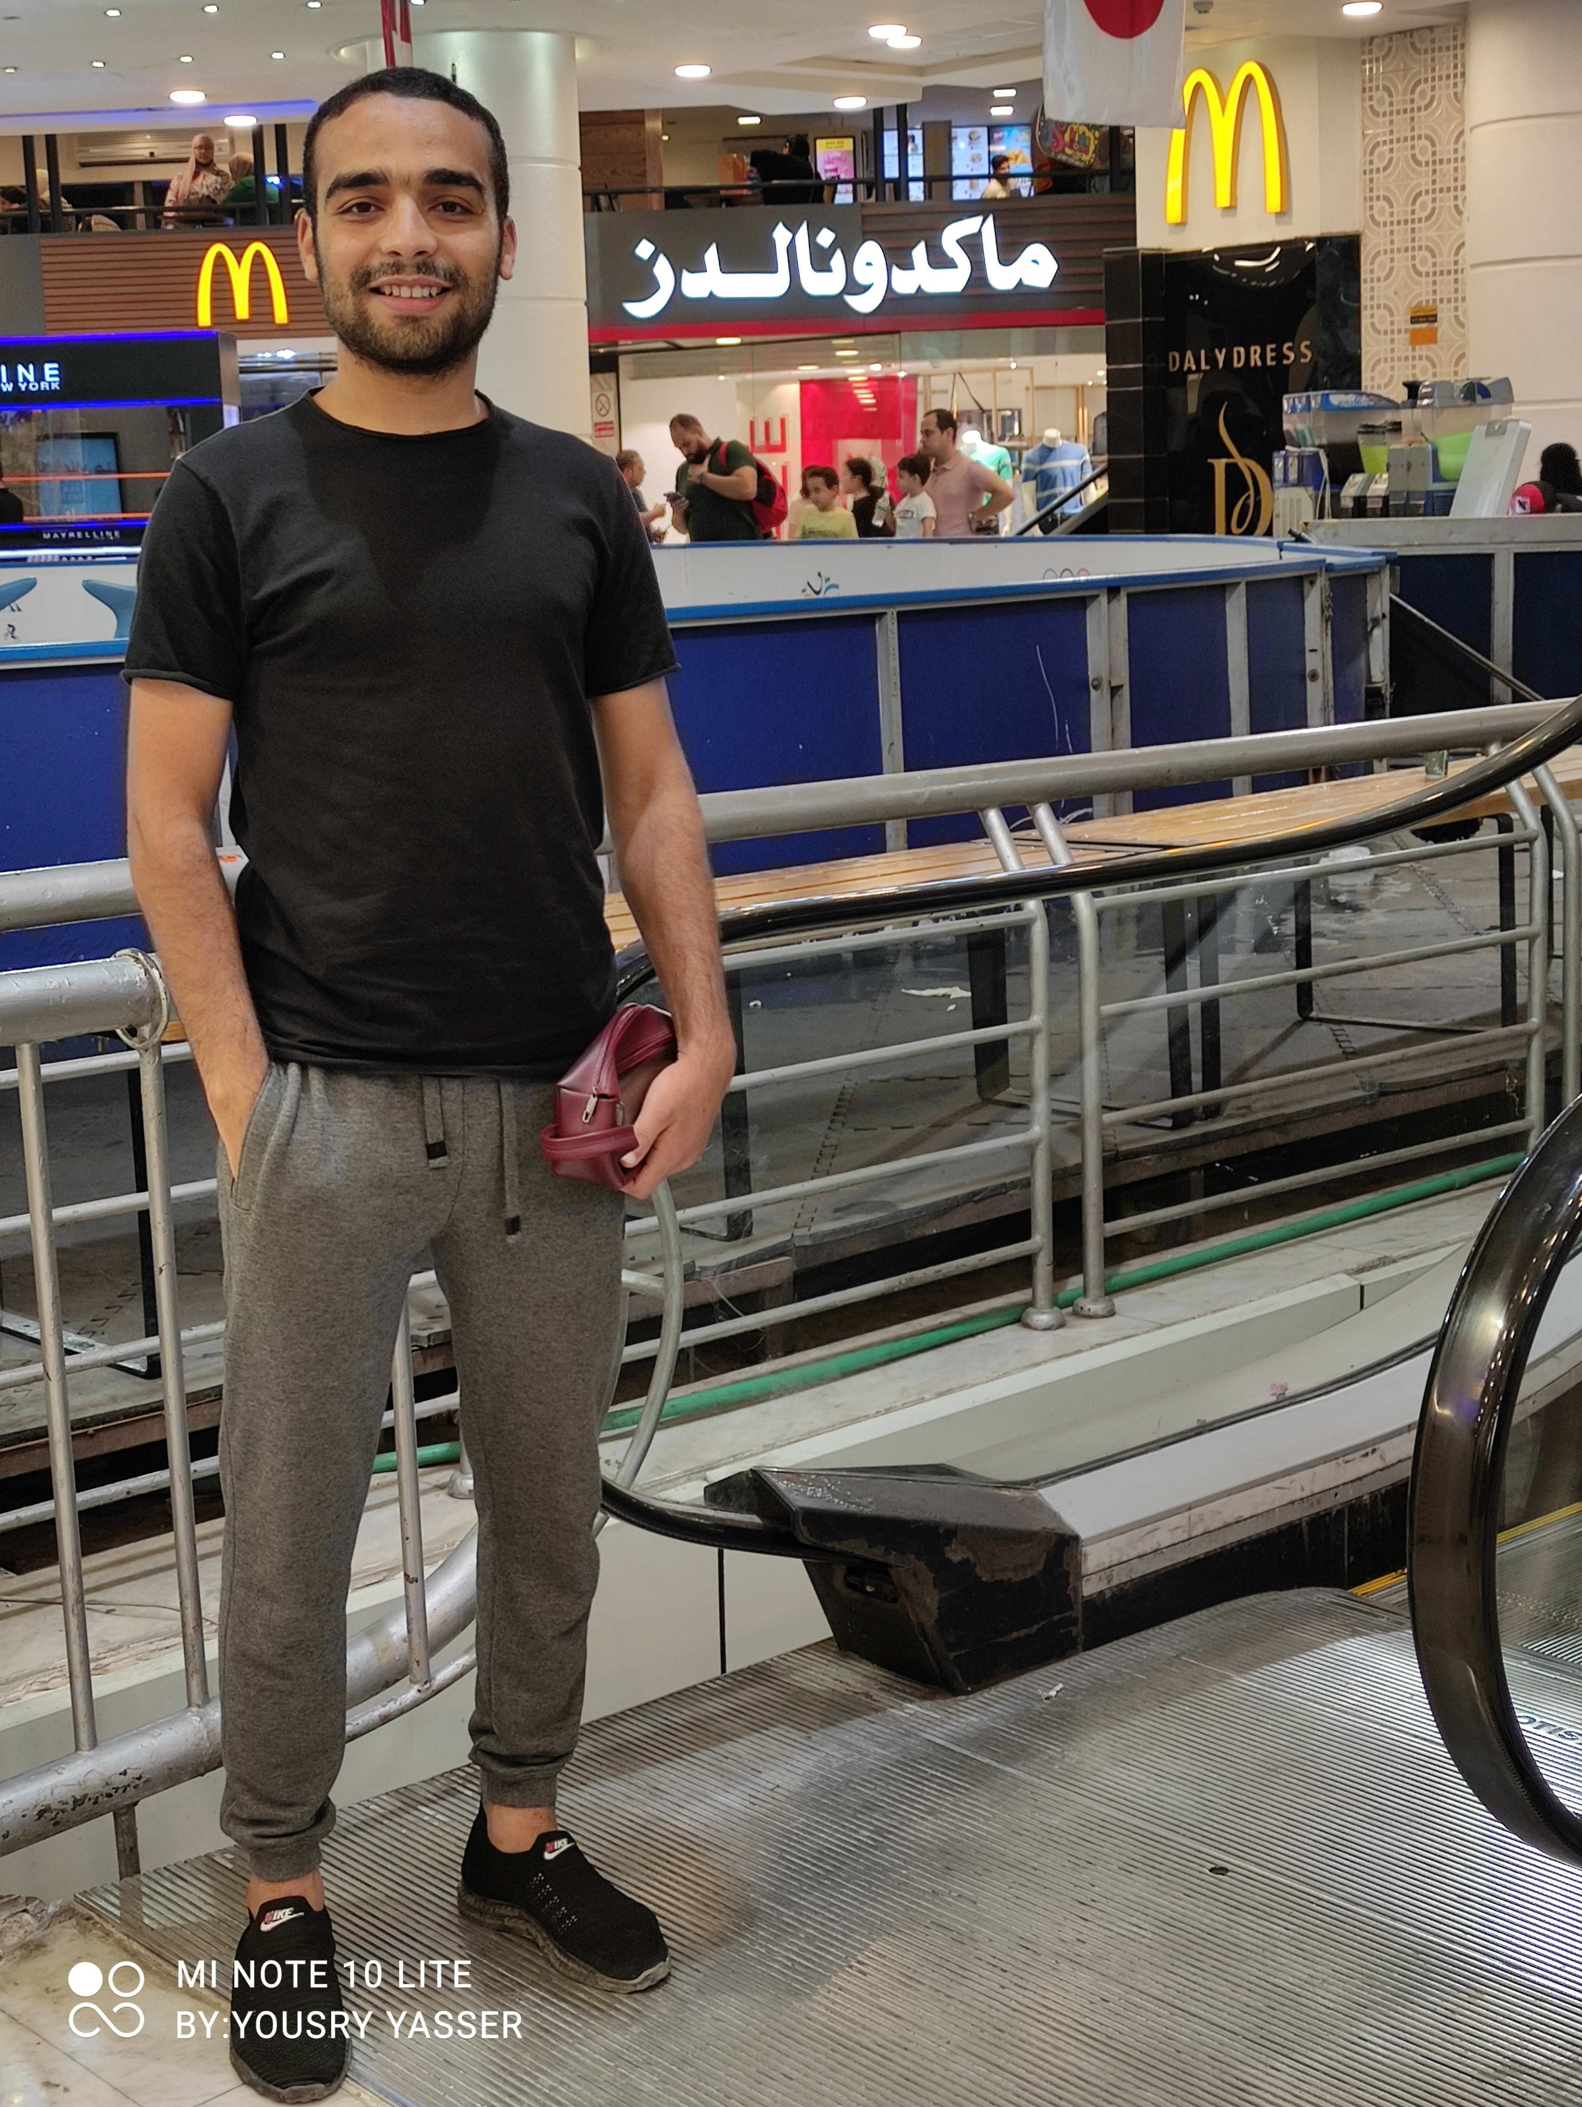
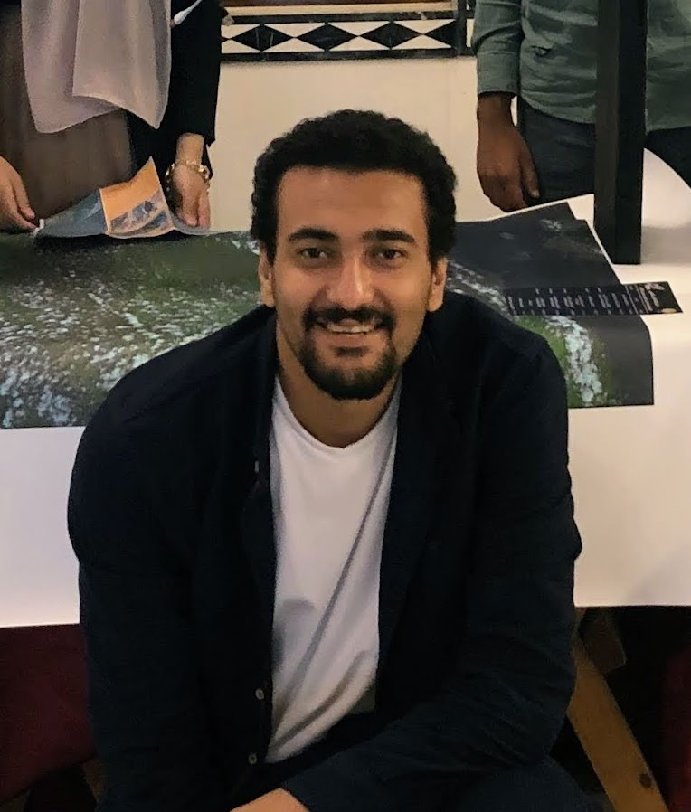
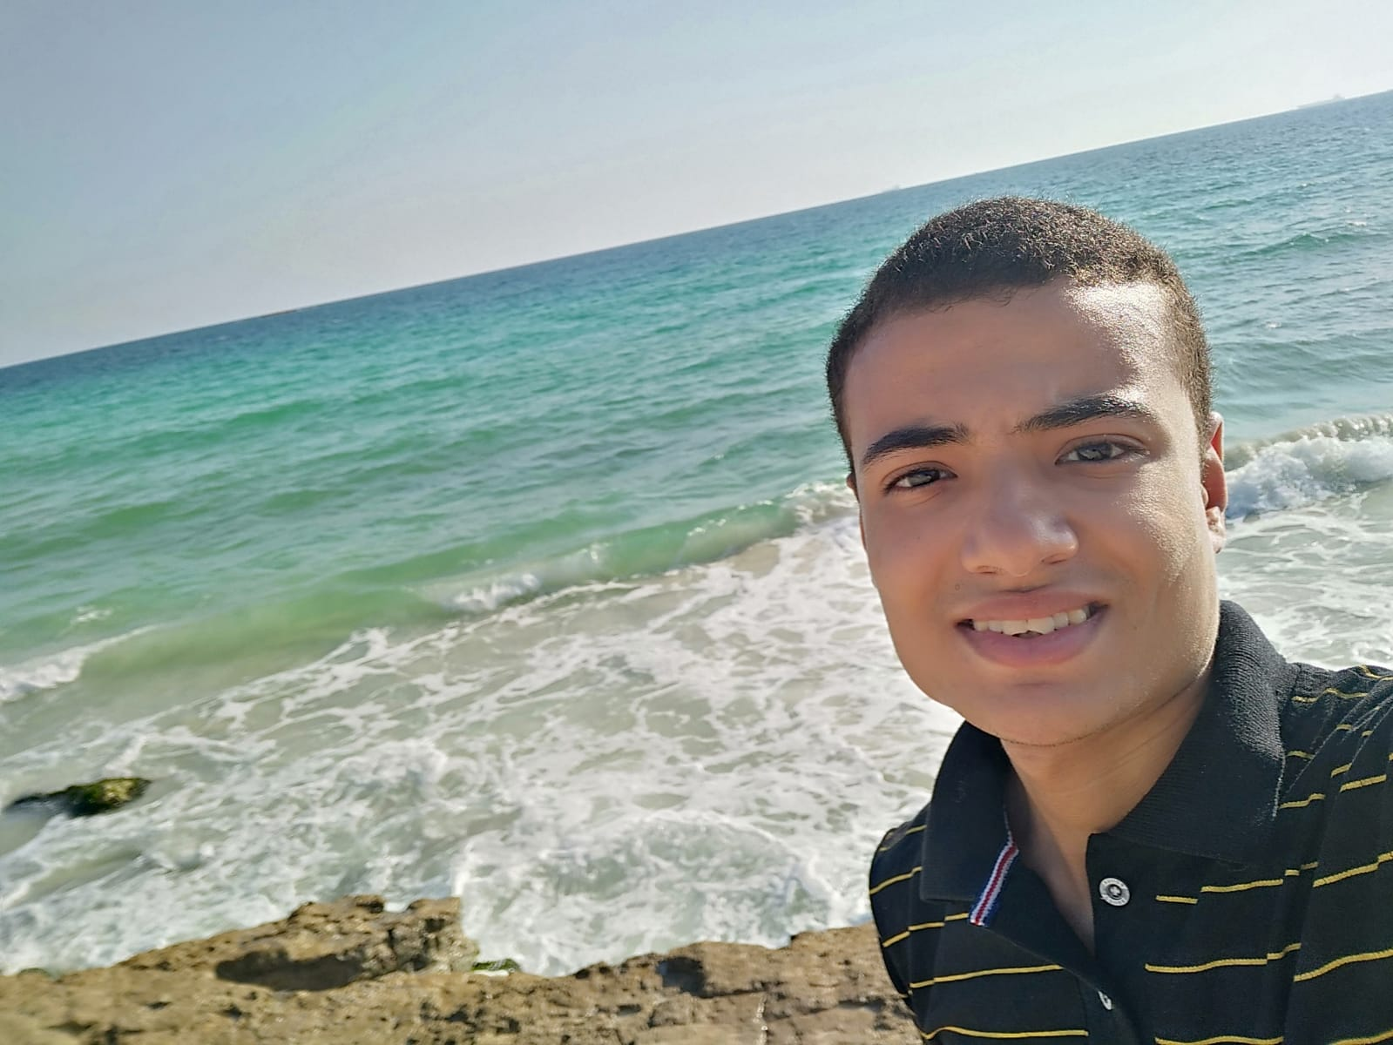



PROJECT TEAM (Crazy Forest(
Mohamed khalid
(Leader)
Mohamed Hassan
Mohamed Saeed
Razan Bassel
Farah Mohamed
Dina Mohamed

Slide 3
Project Overview Why?

Slide 4
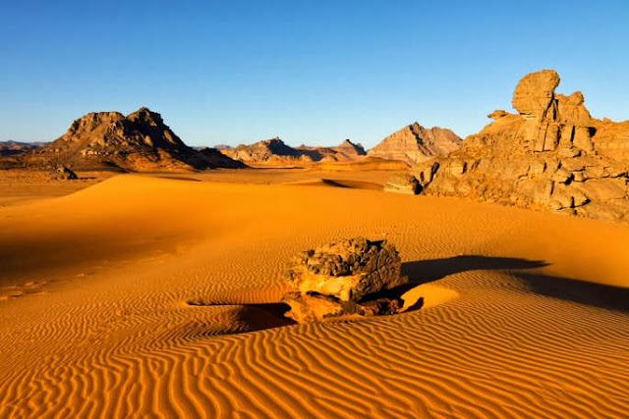
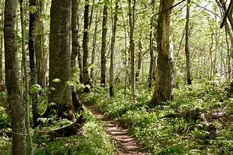
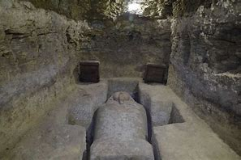
INTRODUCTION (Why..?)
PROBLEM:
- It’s difficult for scientists to be the whole time in the environment that is cruel, dark, cold, and dangerous and the main goal that wanted from scientists is just analyzing the data to out the reasons figure
Exploring places like deserts,
forests,
Archaeological tombs.

Slide 5
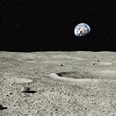
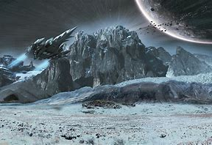
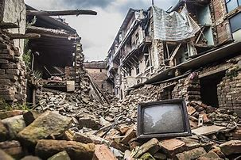
(Why..?)
- There is also main problems that resulted from natural disasters like earthquakes which is detecting if there are any people still alive in the destroyed large buildings.
- Also, possible space in planets and moons

Slide 6
What?

Slide 7
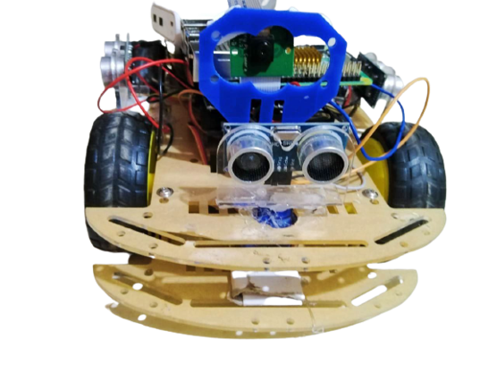
Idea of Our Project (What..? )
SOLUTION:
We designed a self driving robot AlTAIF Rover.
AlTAIF could be very useful as I said there is no need now to endanger the lives of researchers.
We can send our Rover to the place to:
1- Real time Computer Vision by AI techniques.
2- Collecting data about its environment by sensors measurements (Temperature, Humidity, Ultrasonic, Light, Gyroscope, and Speed).
3- Analysis the collecting data and make dashboard.
4- then it will return to us with the desired data and map for the place that would help researchers if they wanted to go and explore some areas by themselves.

Slide 8
IMPORTANCE:
1- Faster than human.
2- Small can move in small places.
3- Decrease time of Exploration.
4- Give information of Temp.
& Humidity.
5- Explore places & Self driving .

Slide 9
GOALS:
Explore places.
Measure Temperature & Humidity.
Walk through maze & Auto driving.
Live object Detection.
Generate map.

Slide 10
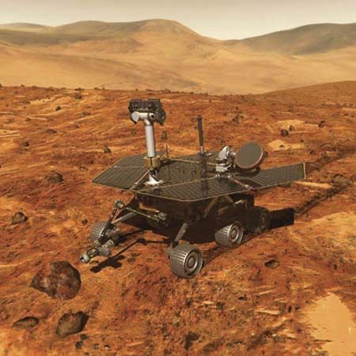
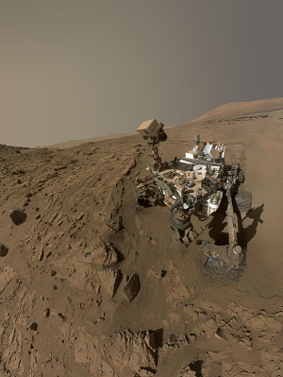
Applied Rovers :
Mars Exploration Rover
To study the chemical and physical composition of the planet’s surface.
To collected data about whether water had ever existed on Mars.
Curiosity Rover
record the geologic history of the area and tell the story of environmental change over millions of years of Mars' history.
Early in its mission, the rover found signs of a past lake at Gale Crater, and evidence that the ancient environment in the area could have supported life..

Slide 11
Tools and Technologies

Slide 12
89,526,124$
185,244 users
100%
TOOLS:
Temperature and humidity sensors (DHT11).
Measure Temperature and Humidity.
Make object detection model.
Raspberry PI 4 model B 8 GB.
Gyroscope MPU6050.
Control the balance of the Rover.
Help in moving of Rover.
Wheals and car kit.
Ultrasonic sensors.
Help in avoid crashing
Control Rovers movement.
Arduino Uno.
PI camera.
Help in detecting objects
Control the electricity of motors
Driver.
Control the movement of the Rover
DC motors.

Slide 13


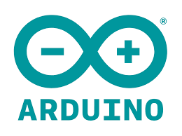




Technologies:
Framework used for the model on Raspberry PI.
Creating application to monitor the rover
PyTorch
Flutter
Arduino IDE
Object detection model
Raspberry PI OS
Control the camera and the object detection model on the car.
Firebase
send the data from hardware to the applicateion
YOLO v5
Python IDE

Slide 14
Diagrams

Slide 15
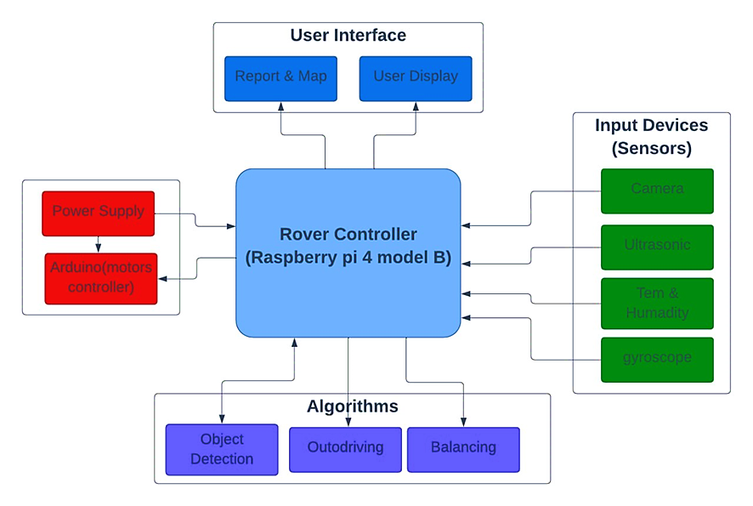
1- Block diagram:

Slide 16
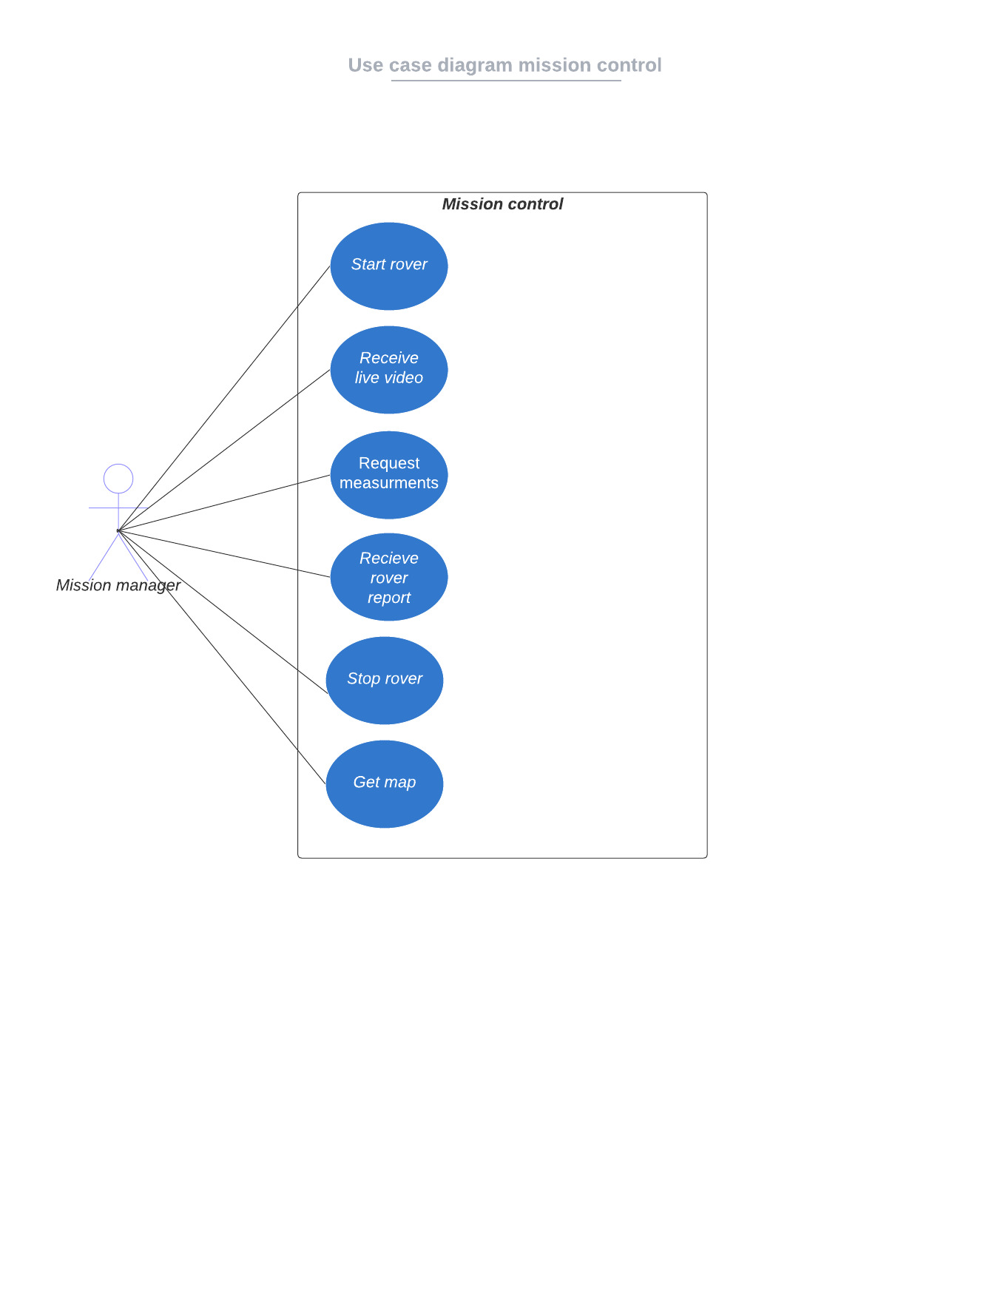
2- Use case mission control :

Slide 17
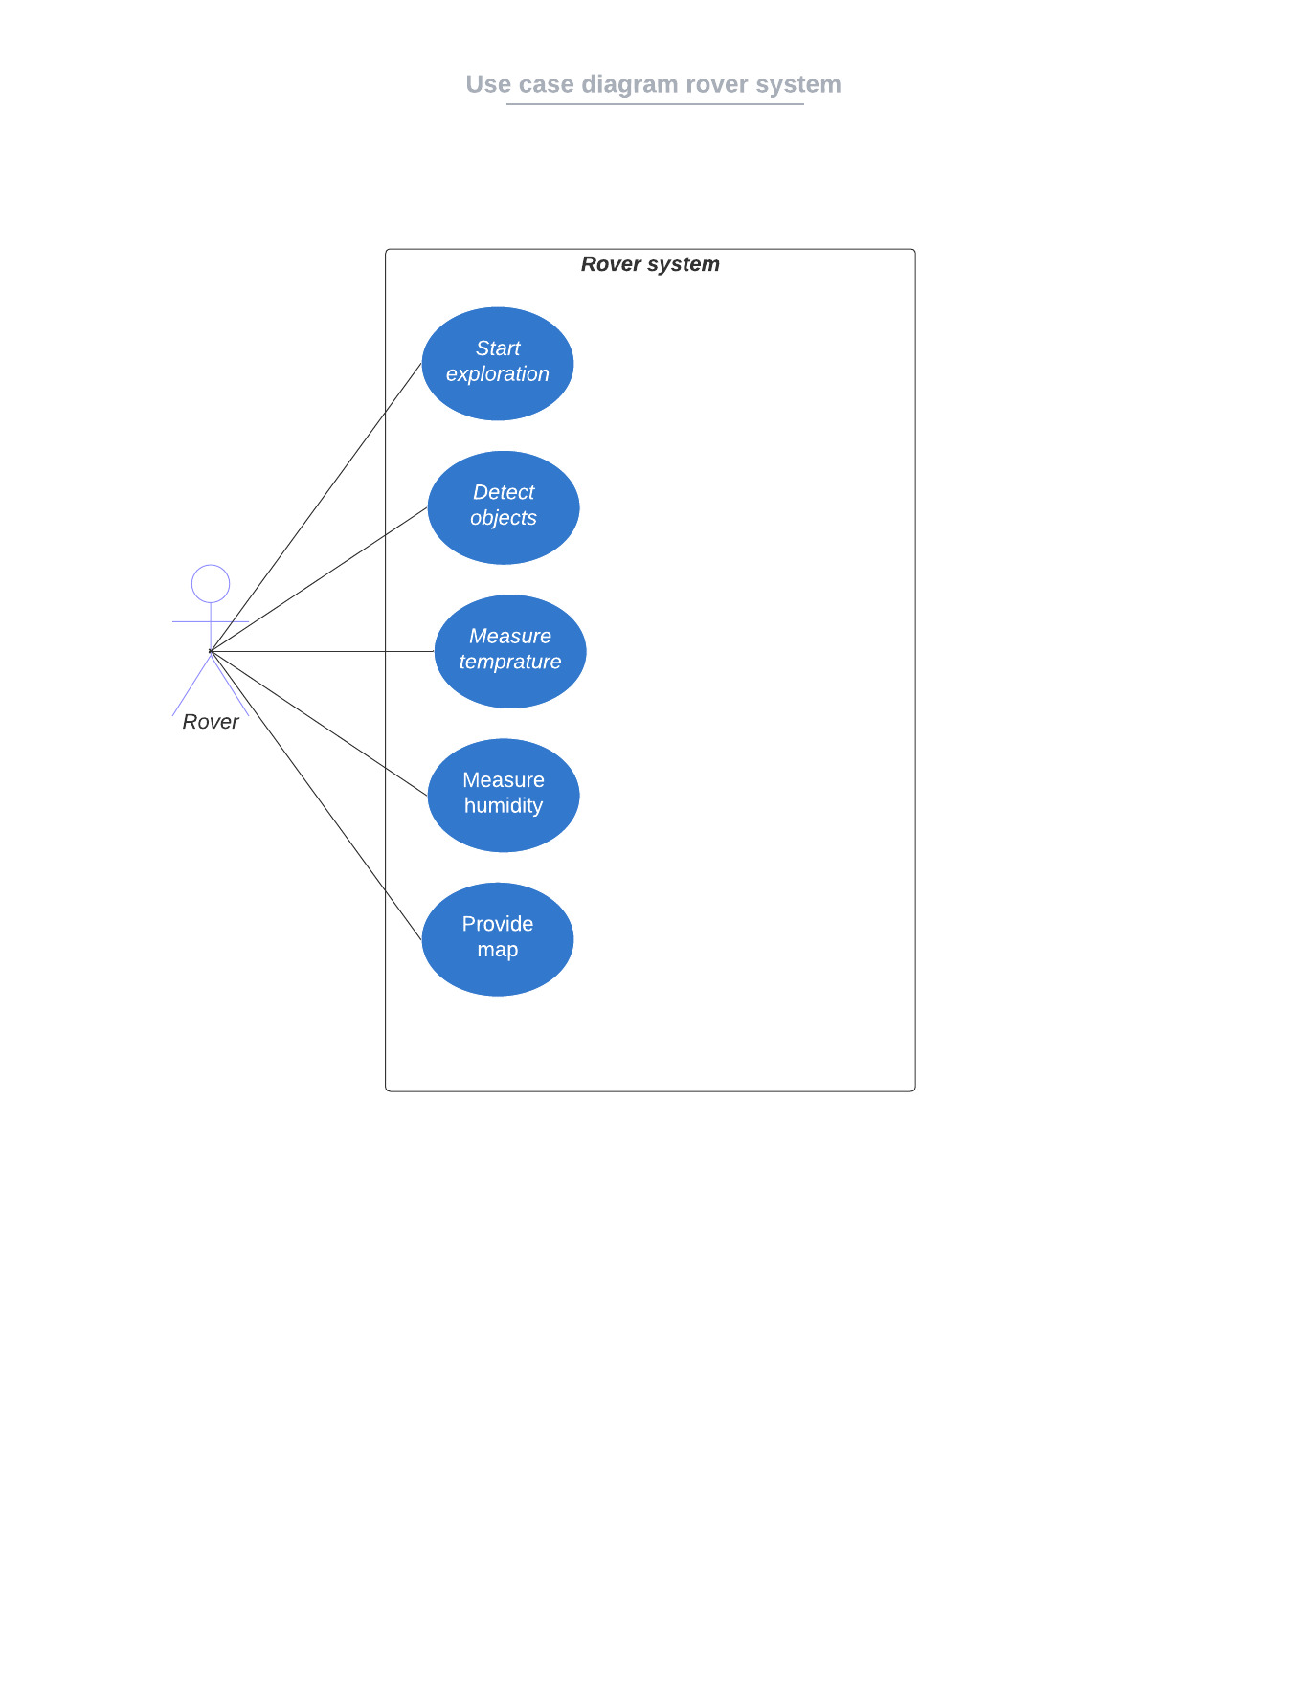
3- Use case diagram of rover system :

Slide 18
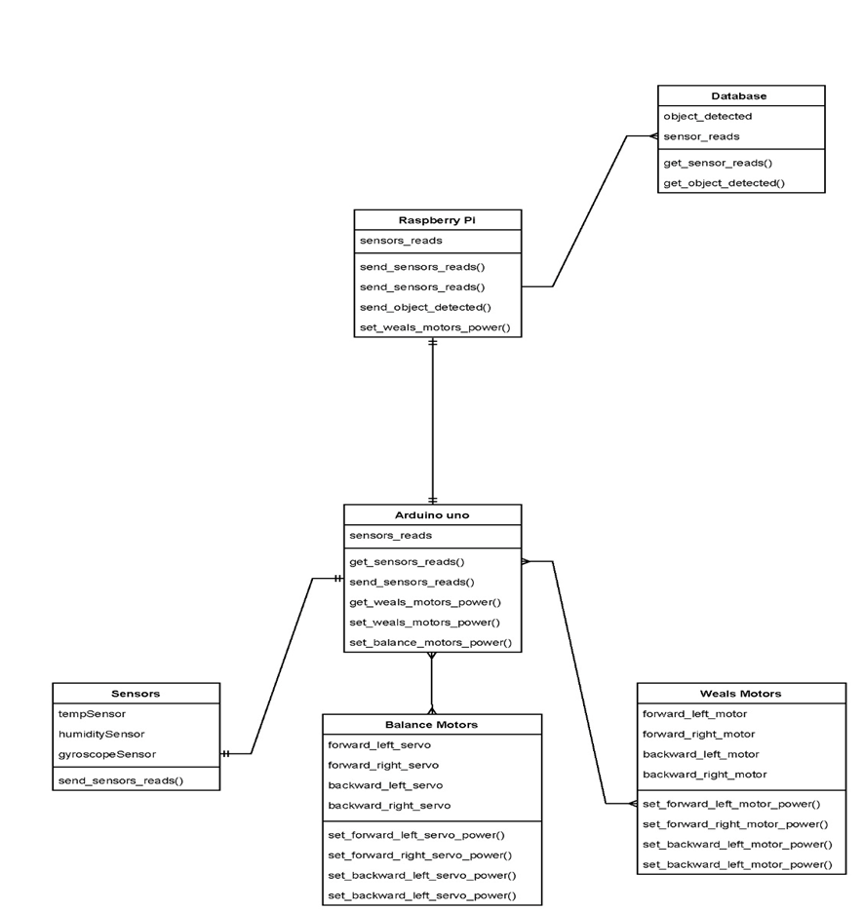
4- Class Diagram :

Slide 19
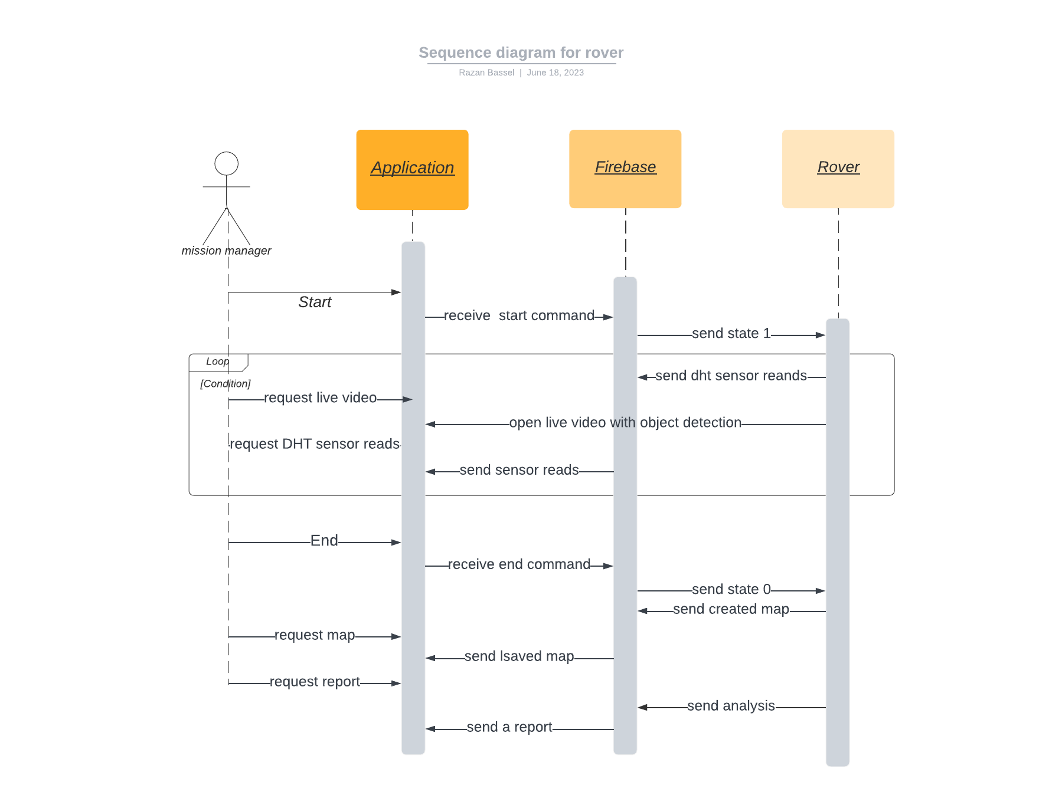
5- Sequence diagram of mission control :

Slide 20
How?

Slide 21
Procedures(How..?):
1- Connection to form rover.
2- Arduino role for Self Diving mechanism.
3- Collecting data from environment by sensors measurements
(Temperature, Humidity, Ultrasonic, Light, Gyroscope, and Speed).
4- Real time Computer Vision by AI techniques.
5- Live video generation.

Slide 22
Procedures(How..?):
6- IOT technology for the communication between Arduino and Raspberry pi.
7- Analysis the collecting data and make dashboard.
8- Simple map generation for the places that the rover visits.
9- Flutter application to control and monitor all tasks.
10- firebase connections.

Slide 23
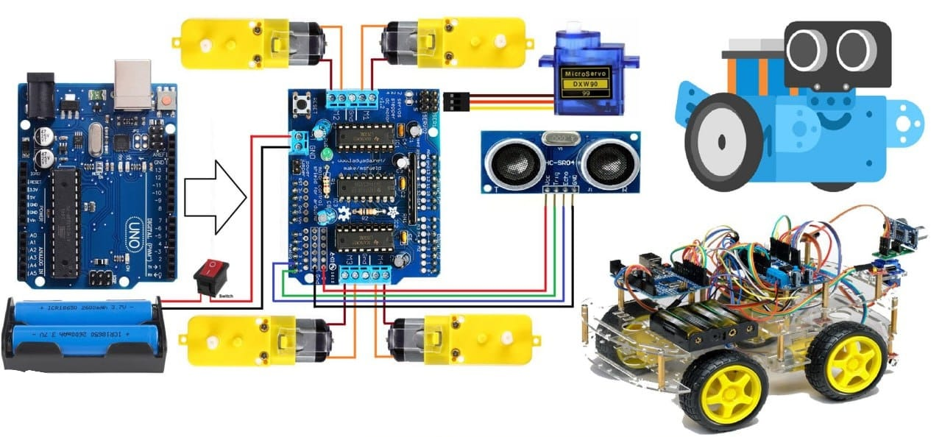
1- Connections to form rover
- Components:
1- Arduino Uno.
2- Wheals and car kit.
3- DC motors.
4- Motors Driver.
5-Ultrasonic sensors.
6-Battary .

Slide 24
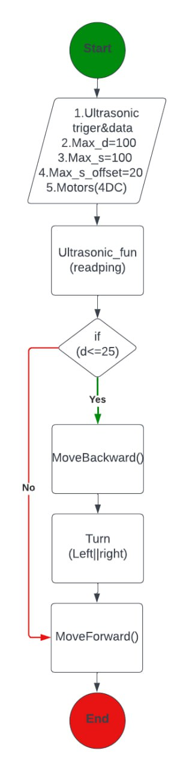
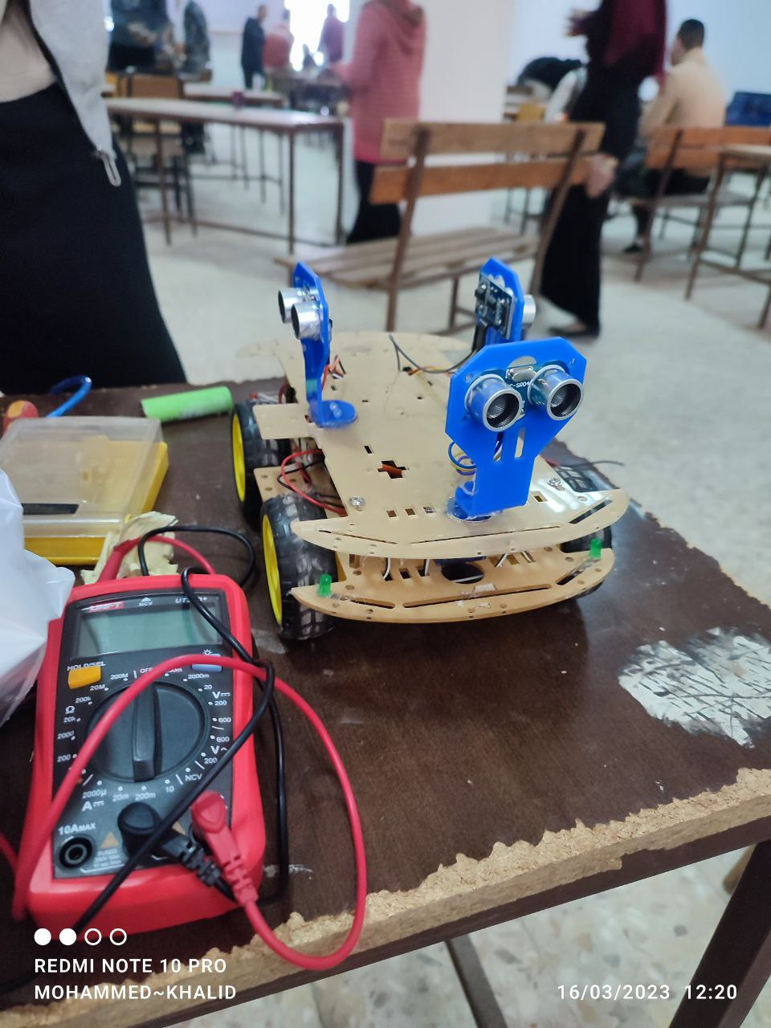
2- Arduino role for Self Diving mechanism.
- Movement Mechanism
- Algorithm (flow chart):

Slide 25
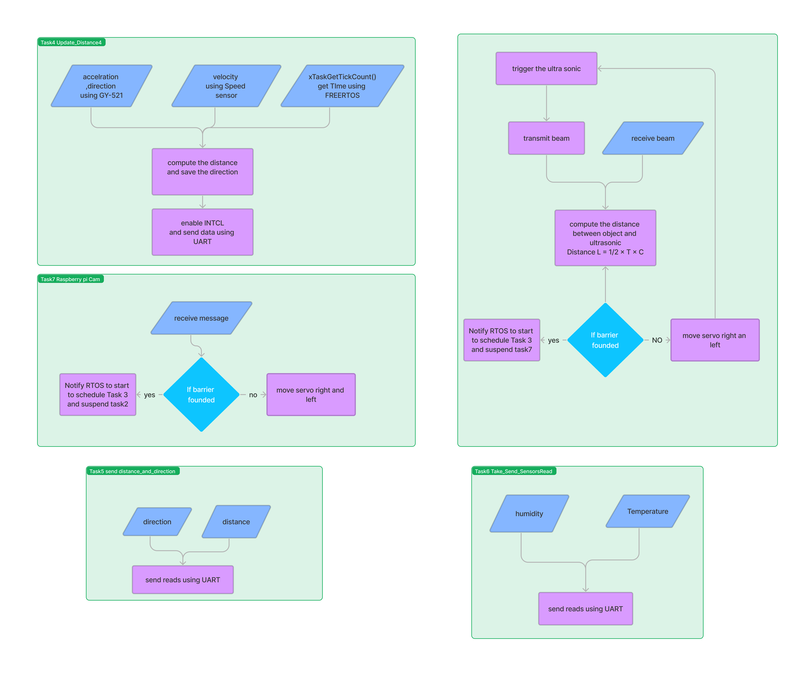
- Arduino Tasks:

Slide 26
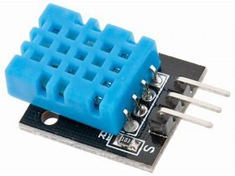
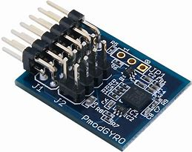
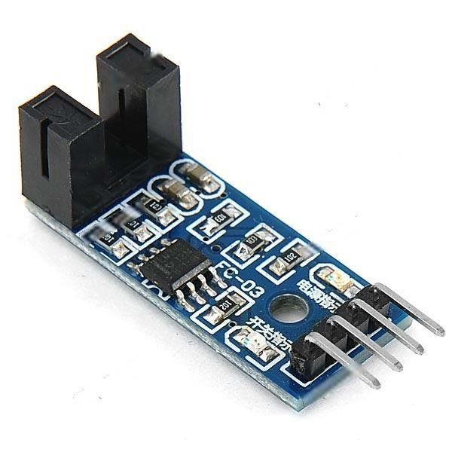
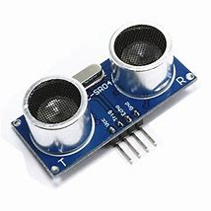
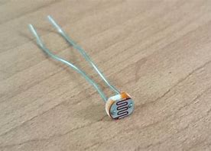
3- Collecting data from environment.
Collecting data from environment by sensors measurements
1- Temperature, Humidity (DH11) sensor
2- Ultrasonic sensor
3- Light sensor
4- Gyroscope sensor
5- Speed sensor

Slide 27
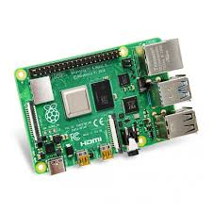
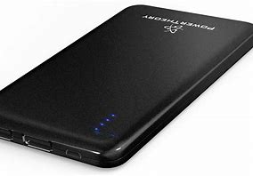
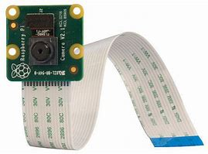
4- Real time Computer Vision by AI techniques.
1-Raspberry pi connection:
- Components:
1- Raspberry PI 4 model B 8 GB.
2- Camera pi
3- Power bank

Slide 28
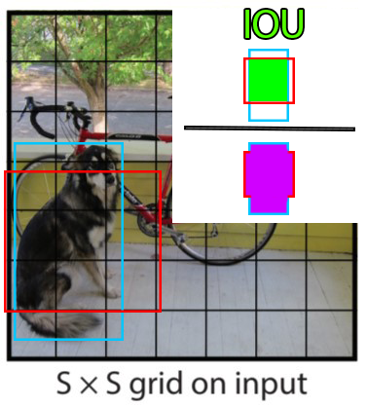
4- Real time Computer Vision by AI techniques.
Object detection model (Yolo):
YOLO(You only look once): Real-Time Object Detection

Slide 29
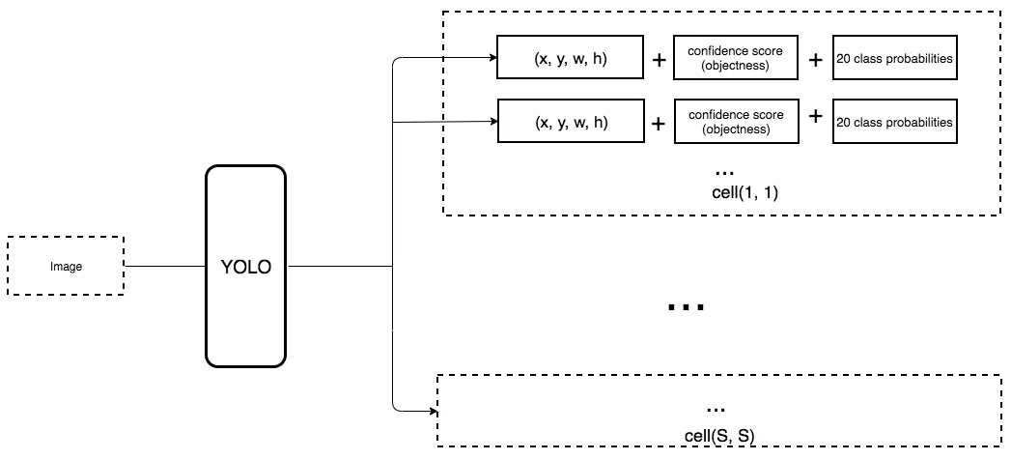
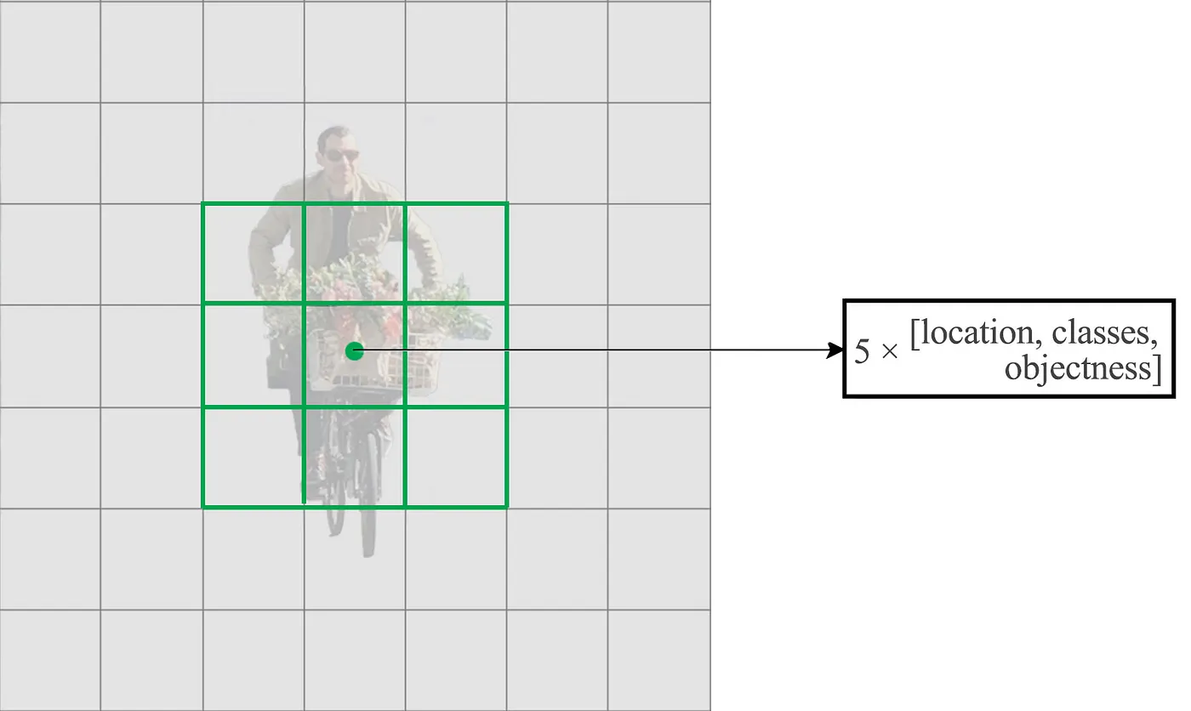
4- Real time Computer Vision by AI techniques.
Now, each prediction includes 4 parameters for the boundary box, 1 box confidence score (abjectness) and 20 class probabilities
This confidence score shows the probability of the image being detected correctly by the algorithm and is given as a percentage.

Slide 30
4- Real time Computer Vision by AI techniques.
A faster but less accurate version of YOLO, called Fast YOLO, uses only 9 convolutional layers with shallower feature maps.

Slide 31
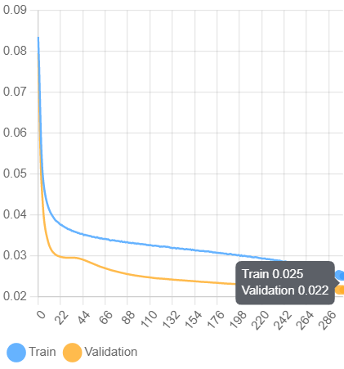
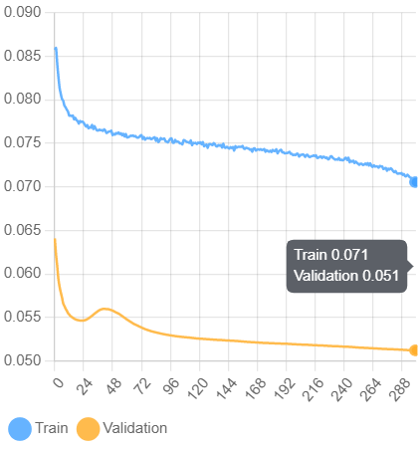
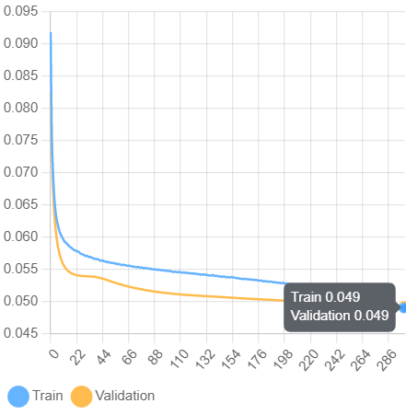
4- Real time Computer Vision by AI techniques.
Box Loss
Class Loss
Object Loss

Slide 32
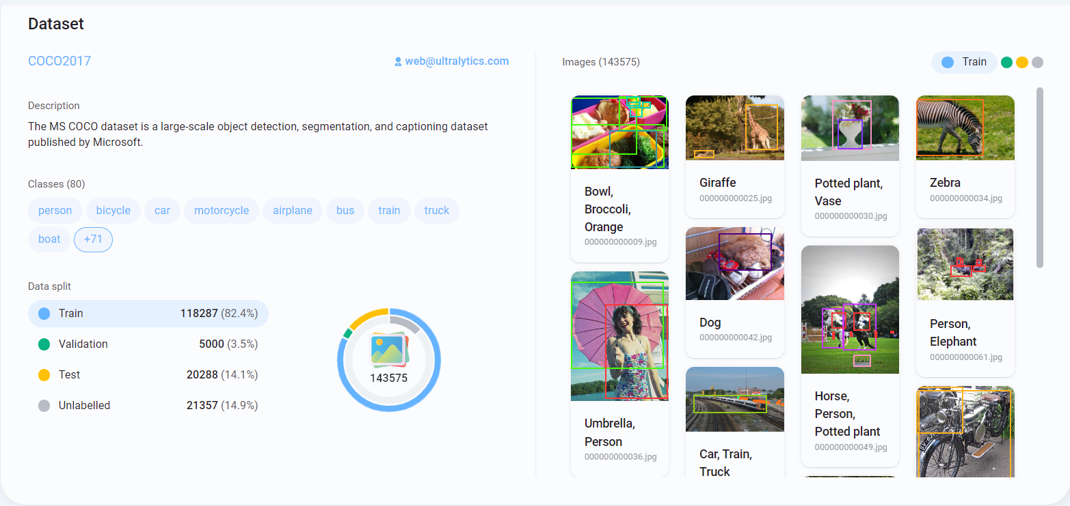
4- Real time Computer Vision by AI techniques.

Slide 33
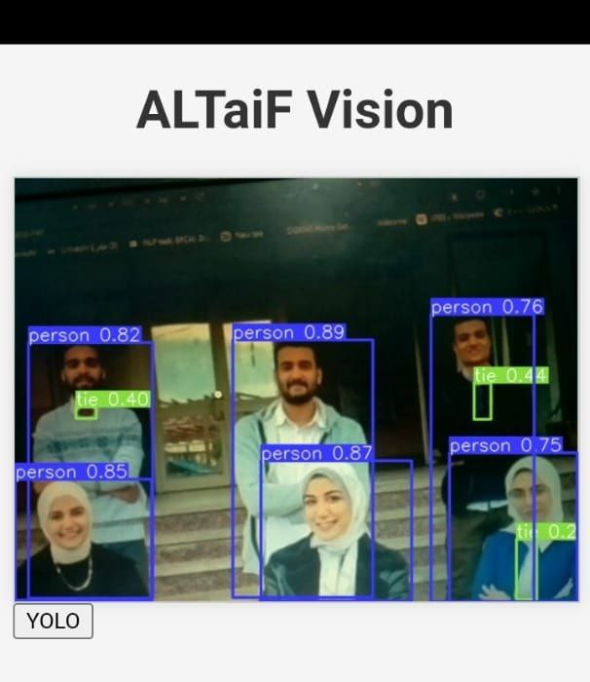

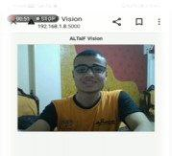
5- Live video Generation.
- The instructions provided outline the steps to set up live video creation using a Raspberry Pi :
1- connecting the camera port and enabling the camera and VNC in the Raspberry Pi Configuration.
2- installing dependencies for the pi camera stream flask library, cloning the pi-camera-stream-flask repository
3- running the main.py file.
4- the YOLO V5 model for object detection is added to the live video streaming.
5- The IP address is used to access the live video stream in a browser or a Flutter application.

Slide 34
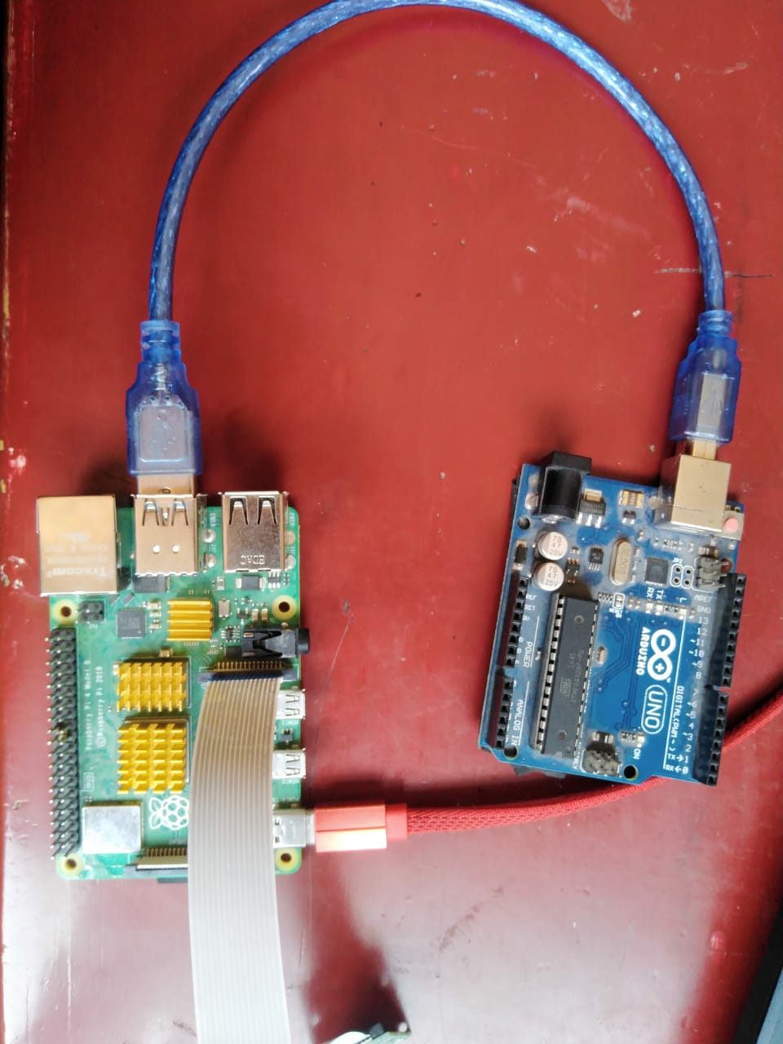
6- IOT technology for communication.
Arduino and Raspberry pi connection using serial port.
ser = serial.Serial('/dev/ttyACM0', 9600, timeout=1)

Slide 35
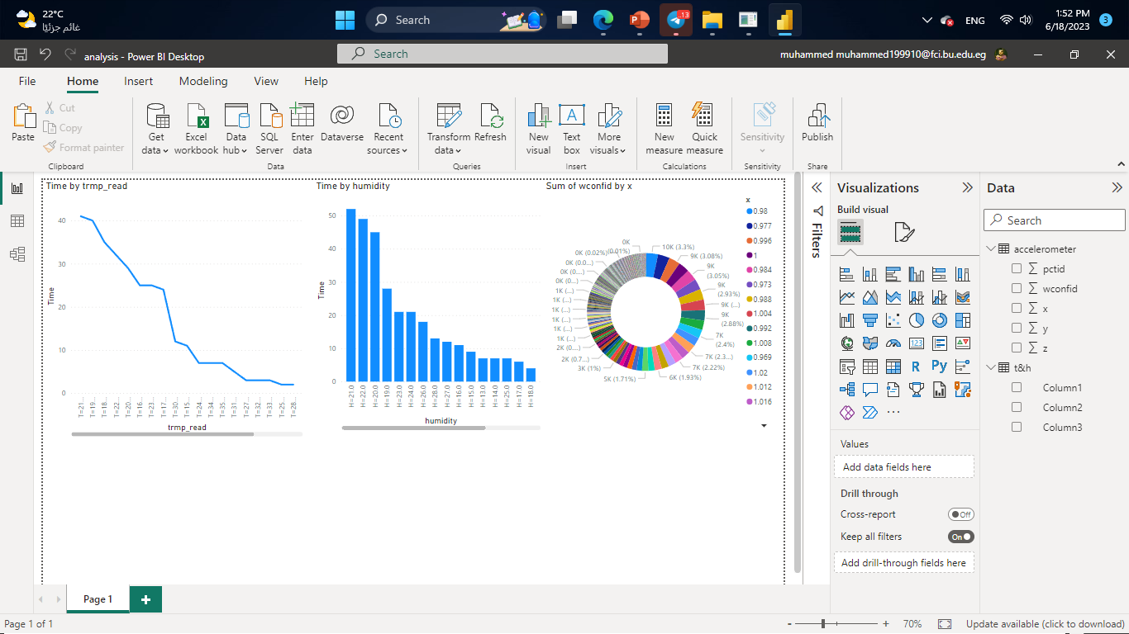
7- Analysis the collecting data and make dashboard.
- Analysis the collecting data and make dashboard by Power BI.
1- Temperature and Humidity sensor reads.
2- Gyroscope reads.

Slide 36

8- Map Generation.
The map is the line that the rover moves in, it is represented as an image and the line is white dots in black background and follow our algorithm.

Slide 37

9- Flutter Application.
Flutter application to control and monitor all tasks.
Why Flutter?

Slide 38

9- Flutter Application.
After opening the application a splash screen appears which shows our special icon for "Rover AlTaif ".

Slide 39
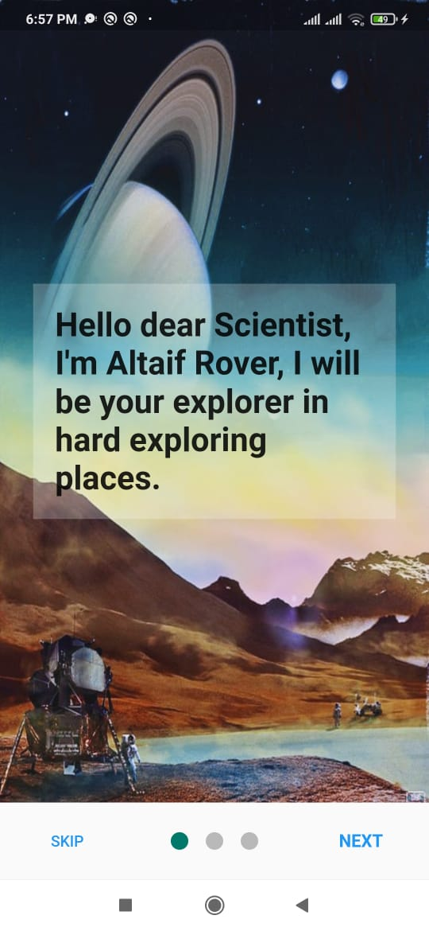
9- Flutter Application.
when user opens the application for the first time, onboarding screens appeared. Onboarding screen typically consist of quick walkthroughs, tooltips, or other UI elements and end with the user taking key steps in the application.

Slide 40
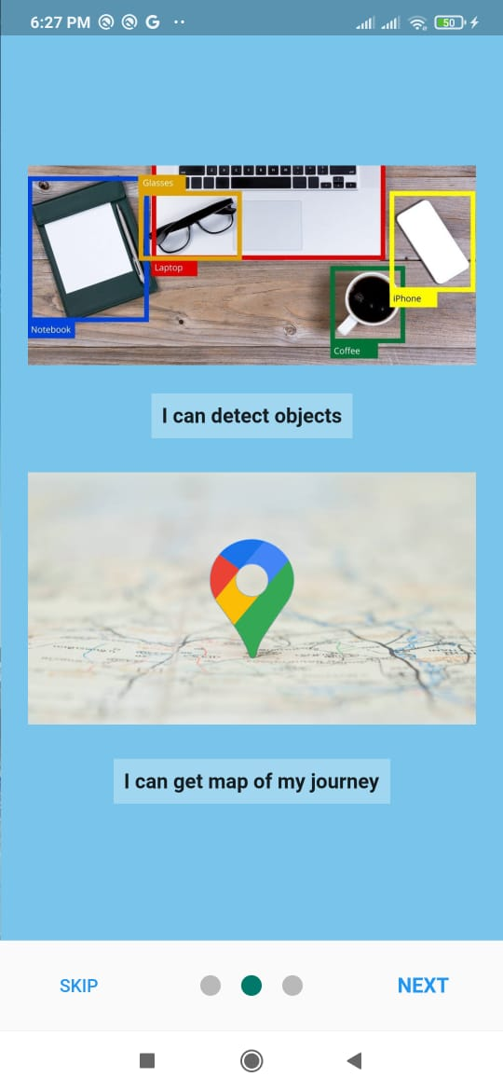
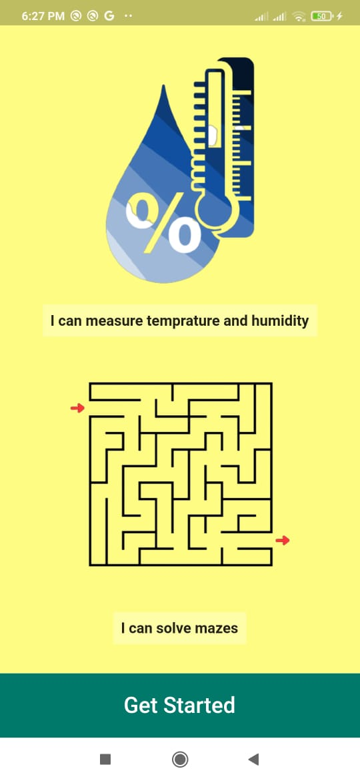
9- Flutter Application.
Second and third screens are about the application’s topic.

Slide 41
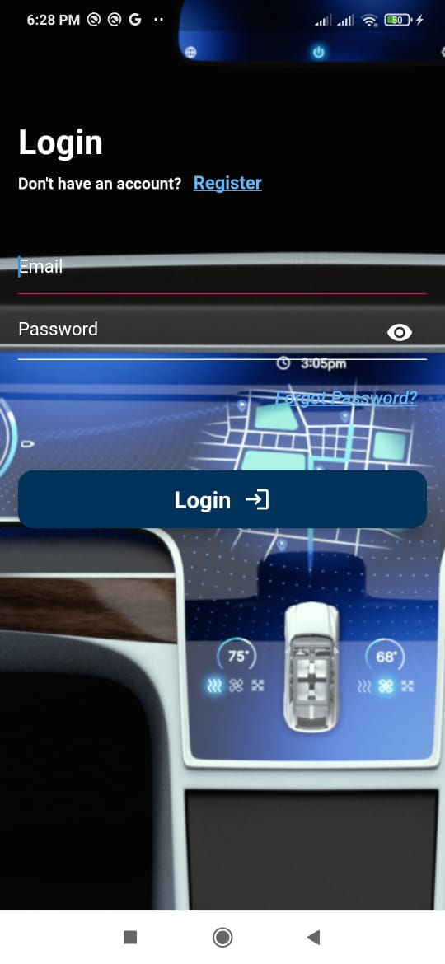
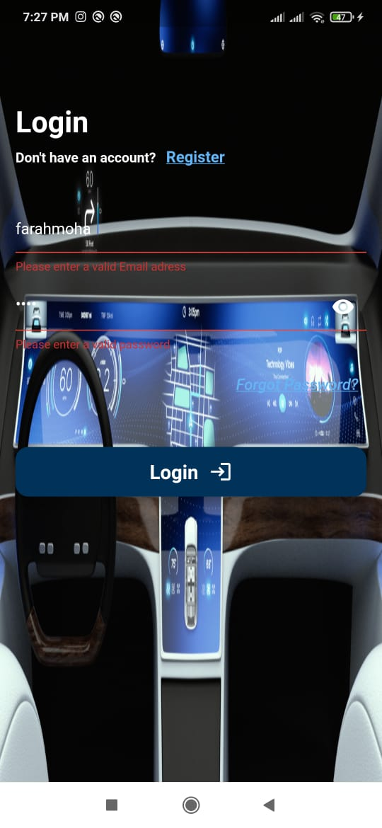
9- Flutter Application.
when the user Get Started he will find the log in screen and have options to log in or to register new account

Slide 42
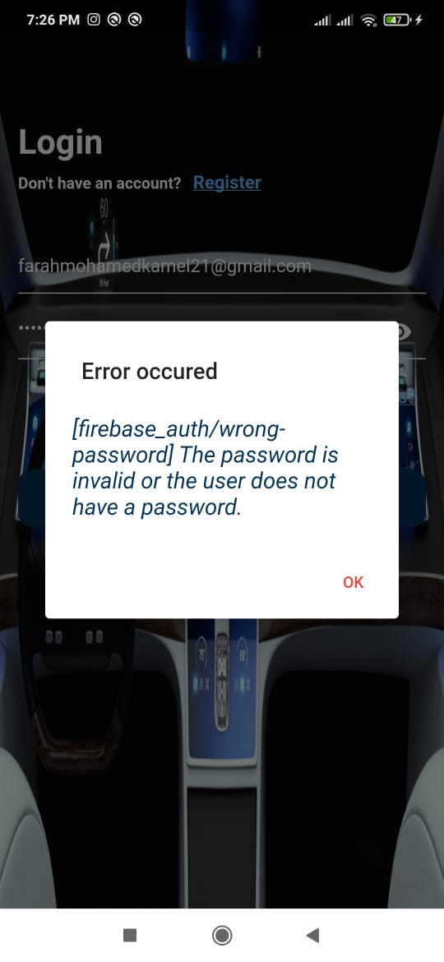
9- Flutter Application.
If the user writes wrong Email or password the app will send a dialog box to show the error.

Slide 43
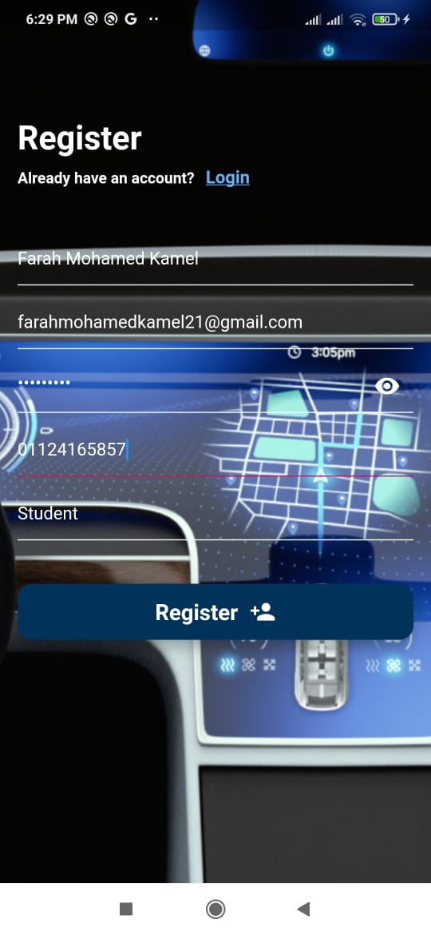
9- Flutter Application.
If the user has no account he will register for a new account by filling his information.

Slide 44
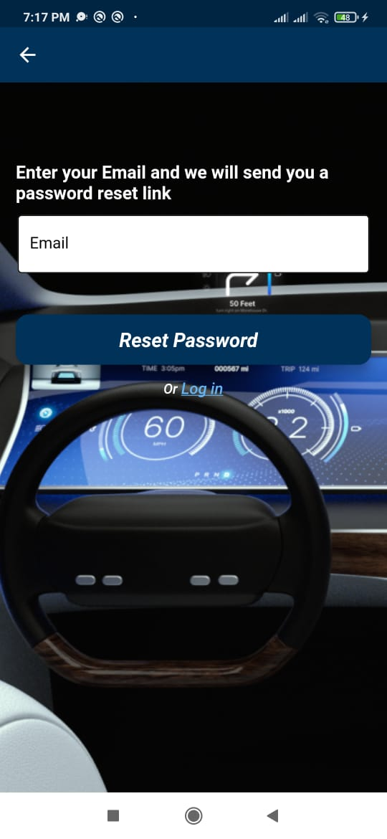
9- Flutter Application.
If the user forgot his password he can press on “Forgot Password?”, and the forgot password screen will appear.

Slide 45


9- Flutter Application.
Then, he will write his registered email and an email of re-entering new password will be sent to him.

Slide 46


9- Flutter Application.
After that, the user can reset his password and sign in with the new password

Slide 47

9- Flutter Application.
After logging in the user now is in the “Main screen”, the user can control the movement of the rover by pressing “Start Rover” button to start moving or “Stop Rover” button to stop moving.
Also, the user can navigate to “Preview” or “Report” screens.

Slide 48

9- Flutter Application.
The user can show his own data by pressing on “My Profile” icon on bottom navigation bar.

Slide 49

9- Flutter Application.
Returning back to the “Main screen” by pressing on “Home” icon.
By pressing on “Preview” the user will have two options: “Live Model” button or “Live Measurements” button

Slide 50


9- Flutter Application.
“Live Model”: to get a live video from the raspberry pi during the rover movement.
When pressing on “YOLO” the Raspberry pi will start to detect objects.

Slide 51

9- Flutter Application.
“Live Measurements”: to get Temperature and Humidity readings from the sensor.

Slide 52

9- Flutter Application.
When the user navigate back to main screen and stops the rover, he then can press on “Report” button to get either the map or the report of measuring sensors.

Slide 53

9- Flutter Application.
“Map”: to show the whole trip of the rover with directions.

Slide 54

9- Flutter Application.
“Report”: to receive all data from sensors.

Slide 55

9- Flutter Application.
The user can return back to main screen and then navigate to “All Maps” icons in the bottom navigation bar to show all the maps the rover made.

Slide 56
10- Firebase Connection
Firebase application provides us database and connection between the hardware and our flutter application to create a full stack project.
In our application we use firebase Authentication, firebase storage and cloud fire store database.

Slide 57

10- Firebase Connection
Linking flutter app with firebase:
First we created a project on firebase and a flutter project , take the application id from flutter project to register app, download config google file and add firebase sdk to the flutter project

Slide 58
10- Firebase Connection
Linking raspberry pi with firebase:
Install firebase library to python, from firebase setting -> database secret choose python then generate a new key.
cred = credentials.Certificate("rover---alteif-firebase-adminsdk-n2s5j-8f3827f523.json")

Slide 59

10- Firebase Connection
Authentication:
We create registration page and login page in our application for Users, each register will store each email and password in the firebase.

Slide 60

10- Firebase Connection
Cloud fire store database
We create a collection Users for user id, Mission for mission’s state, and the Measures for the DHT11 (temperature and humidity) sensor reads.

Slide 61

10- Firebase Connection
Firebase storage
we use firebase storage to receive images of a created maps and created reports of the missions uploaded directly by python to maps folder and to reports folder.

Slide 62
THANK You

